Slide 1

Jawaharlal Nehru National College of Engineering
Department of Computer Science & Engineering
A PRESENTATION ON
“SIMULATION OF BINARY TREE”
Presented by
Mr ASHUTOSH SHENOY P 4JN14CS018
Mr DEEKSHITH B G 4JN14CS027
Under the Guidance of
Mr. MOHAN H G,
Assistant Professor,
Dept. of CSE
Mr. RAVINDRA S,
Assistant Professor,
Dept. of CSE
Mrs. SREEDEVI S,
Assistant Professor,
Dept. of CSE

Slide 2
ABSTRACT
Binary tree is made of nodes, where each node contains a left reference and a right reference and a data element. The topmost node in the tree is called the node. Every node (excluding a root) in a tree is connected by a directed edge from exactly one other node. This node is called a parent. On the other hand, each node can be connected to arbitrary number of nodes, called children. Nodes with no children are called leaves or external nodes. Nodes which are not leaves are called internal nodes. Nodes with the same parent are called siblings. Traversing is a method of visiting each node of tree exactly once in a symmetric order.

Slide 3
AGENDA
Abstract i
Contents iii
List of Figures iv
1 Introduction 1-5
1.1 Computer Graphics 1
1.2 Applications 1
1.3 OpenGL 3
1.4 Problem Statement 4
1.5 Objectives 4
1.6 Organization of the Report 5
2 Binary Tree 6-8
2.1 Working 6
2.2 Design and 6
2.3 Implementation 6
2.4 Summary 8

Slide 4
3 Results 9
3.1 Snapshots 9
3.2 Summary 11
4 Conclusion 12
4.1 Future Scope 12
References 13

Slide 5
INTRODUCTION
Graphics are visual presentations on some surface, such as a wall, canvas, computer screen, paper, or stone to brand, inform, illustrate, or entertain. Graphic design may consist of the deliberate selection, creation, or arrangement of typography alone, as in a brochure, flier, poster, web site, or book without any other element. Clarity or effective communication may be the objective, association with other cultural elements may be sought, or merely, the creation of a distinctive style.

Slide 6
OpenGL
OpenGL (Open Graphics Library) is a cross-language, multi-platform application programming interface (API) for rendering 2D and 3D vector graphics.
The API is typically used to interact with a graphics processing unit (GPU), to achieve hardware-accelerated rendering[1].
OpenGL was developed by Silicon Graphics Inc. (SGI) from 1991 and released in January 1992 and is widely used in CAD, virtual reality, scientific visualization, information visualization, flight simulation, and video games.

Slide 7
SIMULATION OF BINARY TREE
Traversing is a method of visiting each node of tree exactly once in a symmetric order . Binary tree traversal technics are of three types:
Preorder - Processing of the root node then traversing the left sub tree in preorder and traversing the right sub tree in preorder.
In order - Traversing the left sub tree in order then processing of the root node and then traversing the right sub tree in order.
Post order - Traversing the left sub tree in post order and then traversing the right sub tree in post order and processing of the root.

Slide 8
OBJECTIVES
Enhance the visual implication of the data structure.
Implement the various Open GL APIs like mouse and keyboard interactions .
Construct a complete binary tree .
Display the various tree traversal methods .

Slide 9
PROBLEM STATEMENT
Formation of binary tree of maximum level two, by accepting inputs from the user. The project should make use of various Open GL API’s to construct the binary tree . The binary tree traversal methods are to be displayed.

Slide 10
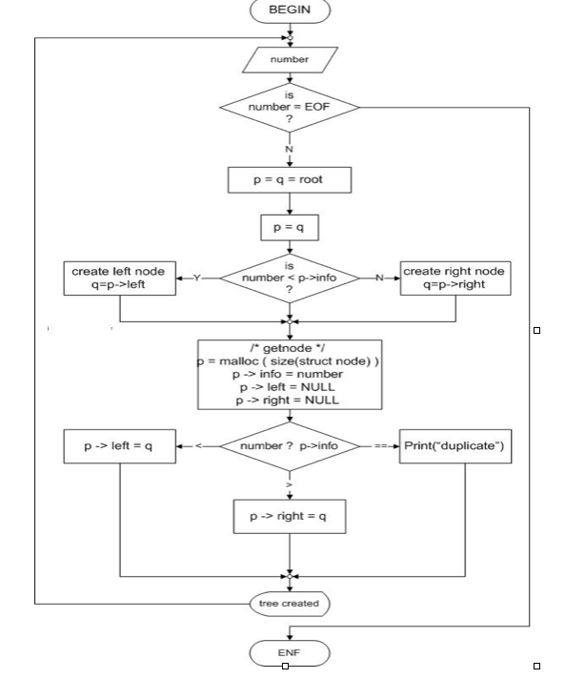
DESIGN

Slide 11
IMPLEMENTATION
•Void glBegin (glEnum mode)
Initiates a new primitive of type mode and starts the collection of vertices. Values of mode include GL_POINTS, GL_LINES and GL_POLYGON. [3]
•Void glEnd ( )
Terminates a list of vertices.
• Void glColor3f [i f d ] (TYPE r, TYPE g, TYPE b)
Sets the present RGB colors. Valid types are integer (I), float (f) and double (d). The maximum and minimum values of the floating-point types are 1.0 and 0.0, respectively.
• Void glClearColor (GLclampf r, GLclampf g, GLclampf b, GLclampf a)
Sets the present RGBA clear color used when clearing the color buffer. Variables of GLclampf are floating-point numbers between 0.0 and 1.0.

Slide 12
• Int glutCreateWindow (char *title)
Creates a window on the display. The string title can be used to label the window. The return value provides a reference to the window that can be used where there are multiple windows.
•Void glutInitWindowSize (int width, int height)
Specifies the initial height and width of the window in pixels.
• Void glutInitWindowPosition(int x, int y)
Specifies the initial position of the top-left corner of the window in pixels.
• Void glutInitDisplayMode (unsigned int mode)
Request a display with the properties in mode. The value of mode is determined by the logical OR of operation including the color model (GLUT_RGB, GLUT_INDEX) and buffering (GLUT_SINGLE, GLUT_DOUBLE).

Slide 13
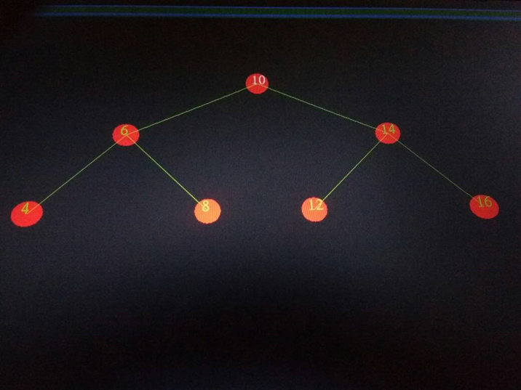
RESULTS
Figure : Snapshot showing the binary tree.

Slide 14
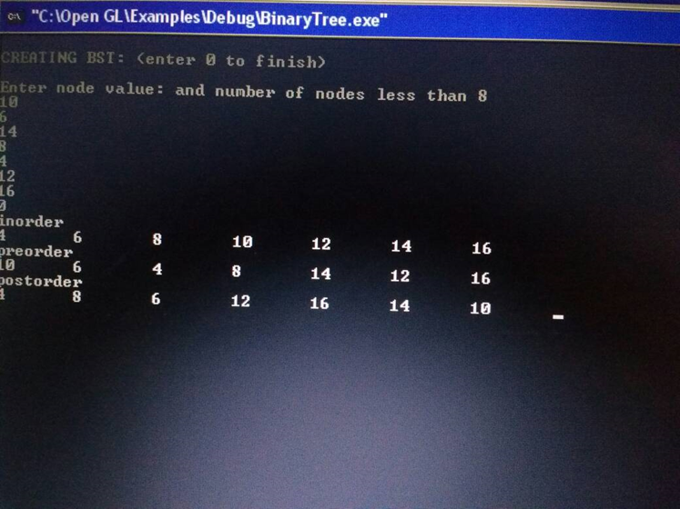
Figure Snapshot showing the tree traversal .

Slide 15
CONCLUSION
The project has used various Open GL API’s to implement binary tree . An effort to show case the tree traversal technique is also been made.The program takes the input from the user.

Slide 16
FUTURE SCOPE
There is possibility of extending the tree structure beyond level two. Delay can be implemented in order to represent the tree traversal. Instead of the keyboard function a menu can be implemented to select among the traversal technique .

Slide 17
REFERENCES
[1] | Interactive Computer Graphics A Top-Down Approach with OpenGL – Edward Angel, 5th edition, Addison-Wesley, 2008
[2] | Horowitz , Sahni , Anderson - Freed : Fundamentals of data structure in C , 2nd Edition , Universities press , 2007
[3] | https://www.opengl.org/resources/libraries/glut/spec3/node10.html

Slide 18
THANK YOU

